Slide 1
Readout Error Mitigation (2)
Comparing Two Fold vs Three Fold Majority Logic
November 3, 2020 (Election Day!)

Slide 2

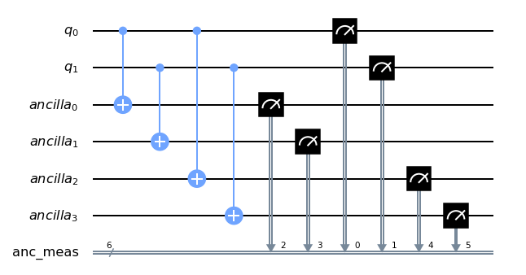
Example of Three Fold Majority Logic
After the transformation shown on the side, only symmetric outputs (like ‘010101’ but not ‘000111’) are accepted

Slide 3
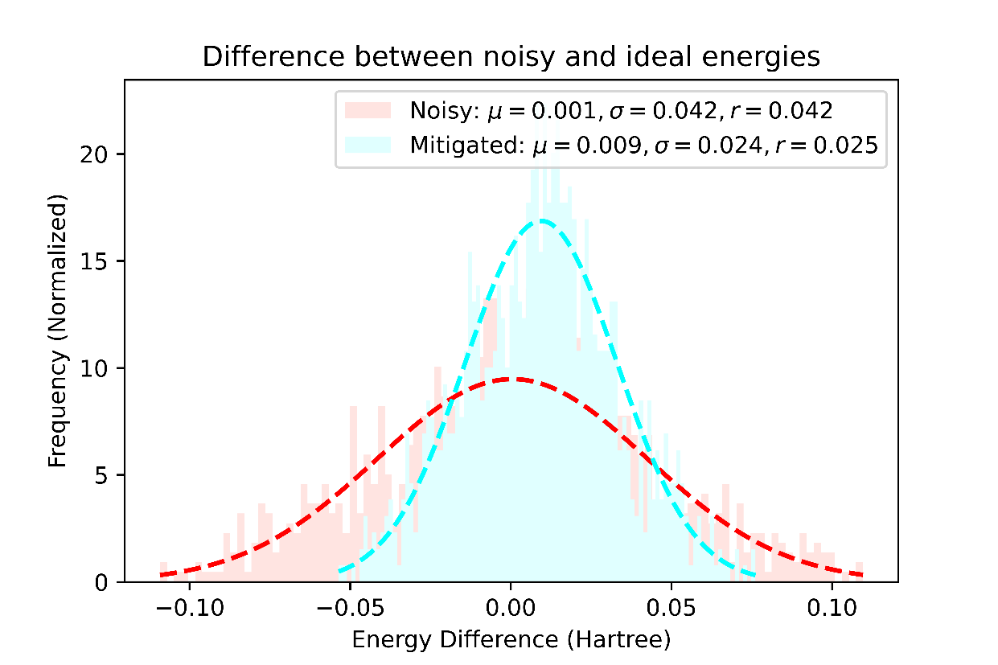
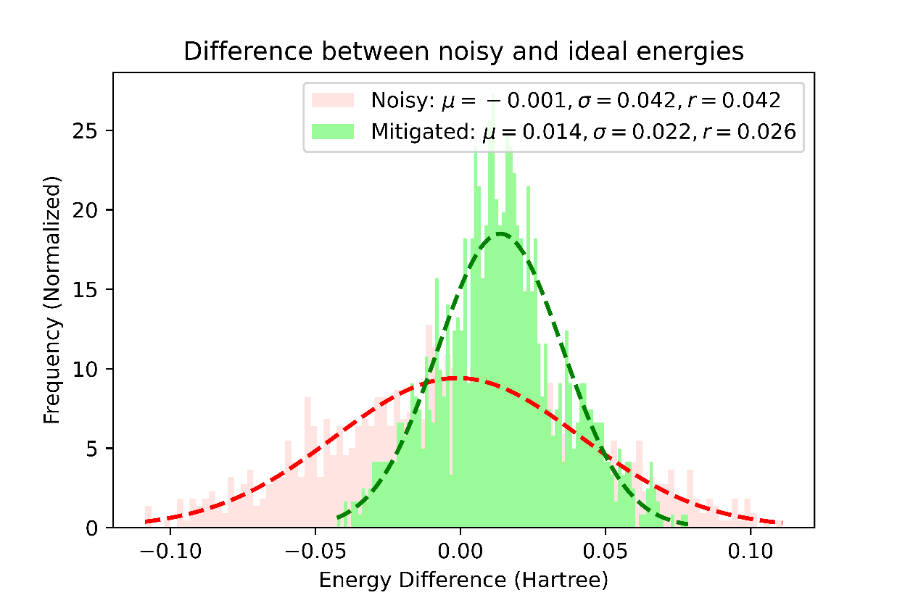
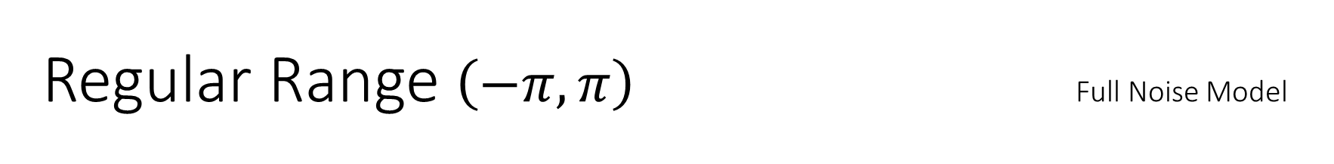
Regular Range $\left(−π, π\right)$ Full Noise Model
Two Fold Majority Logic
Three Fold Majority Logic
‘r’ = rms

Slide 4
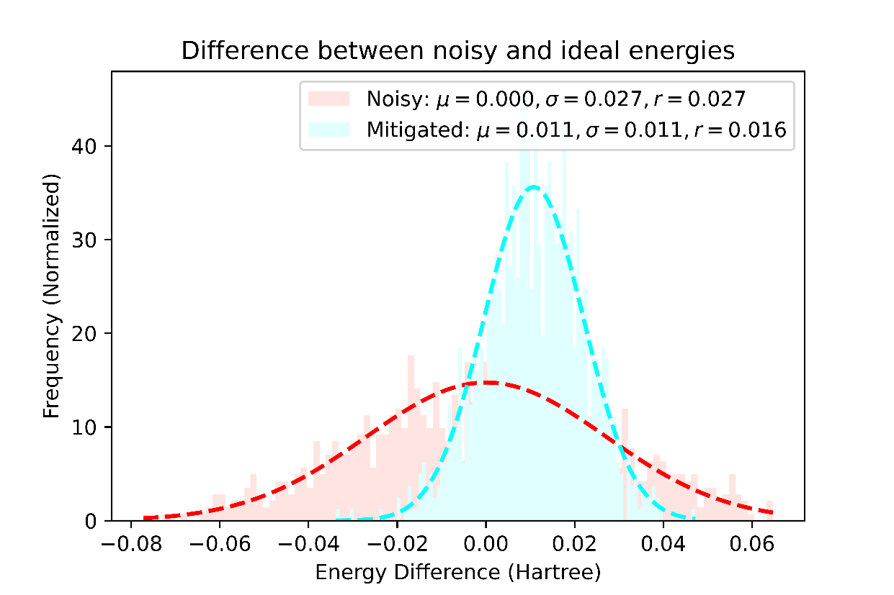
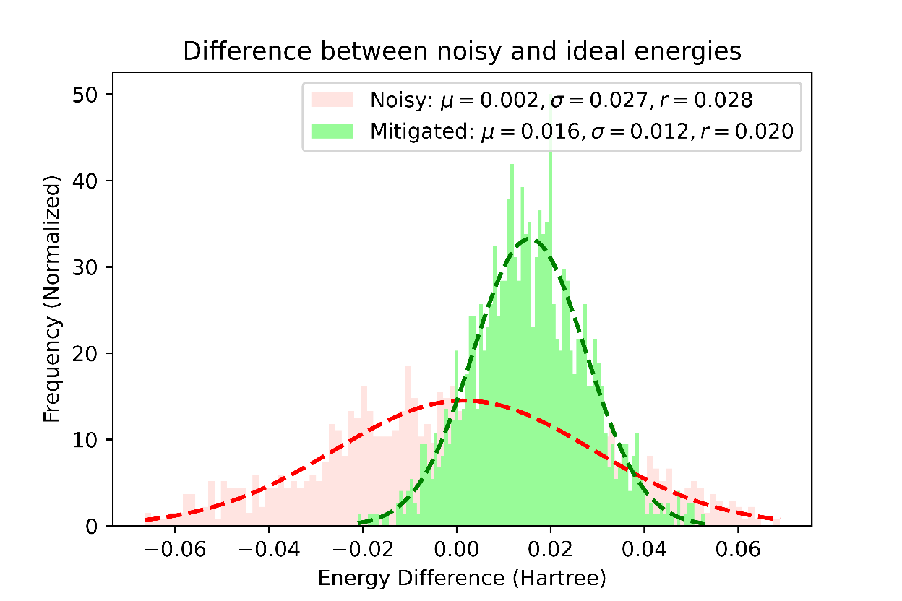
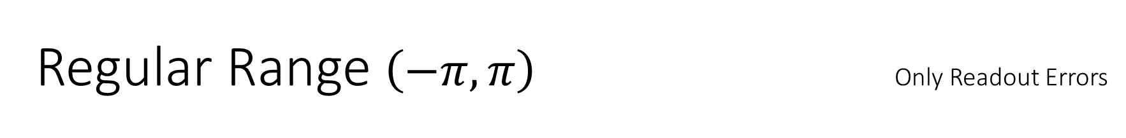
Regular Range $\left(−π, π\right)$ Only Readout Errors
Two Fold Majority Logic
Three Fold Majority Logic

Slide 5
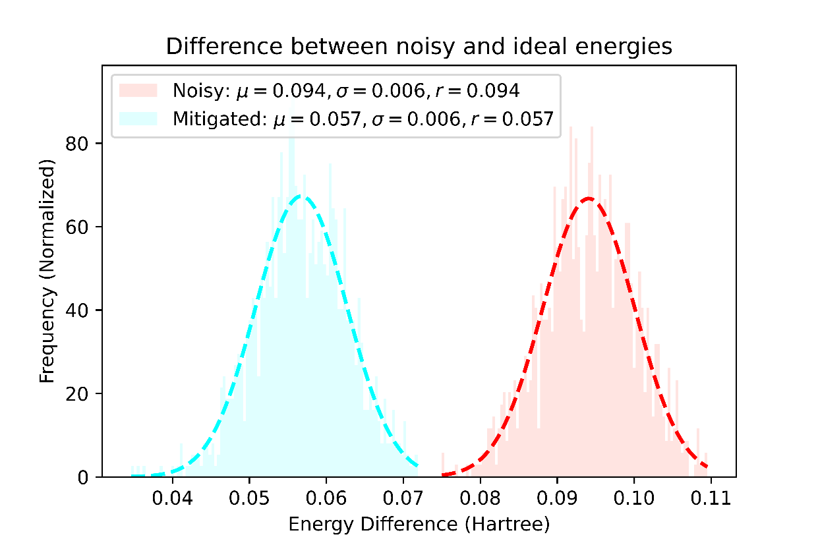
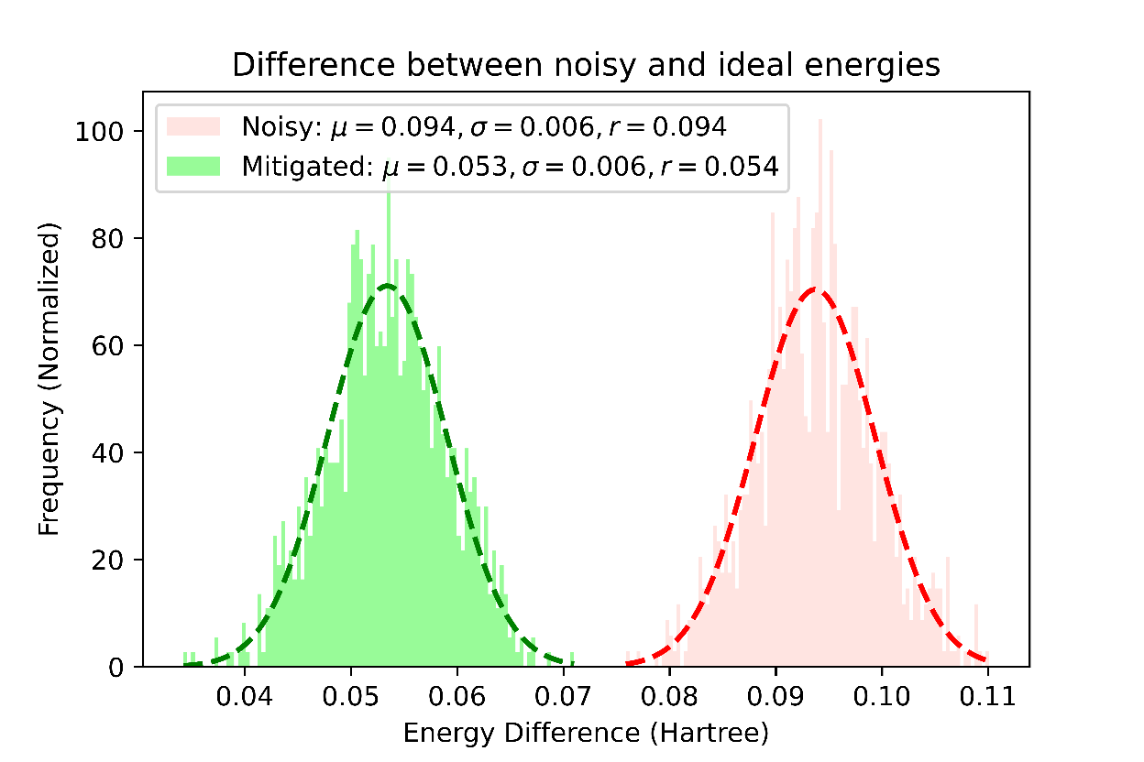
Restricted Range [(0.001, 0.002),(-0.002, -0.001), (-0.2, -0.1)] Full Noise Model
Two Fold Majority Logic
Three Fold Majority Logic

Slide 6
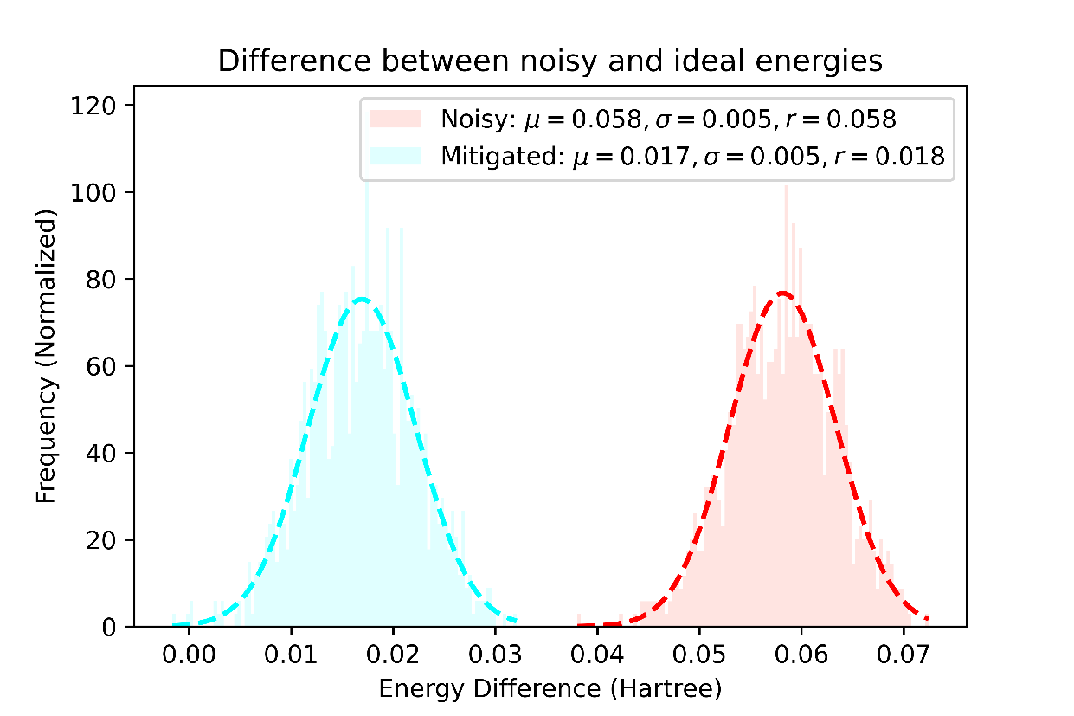
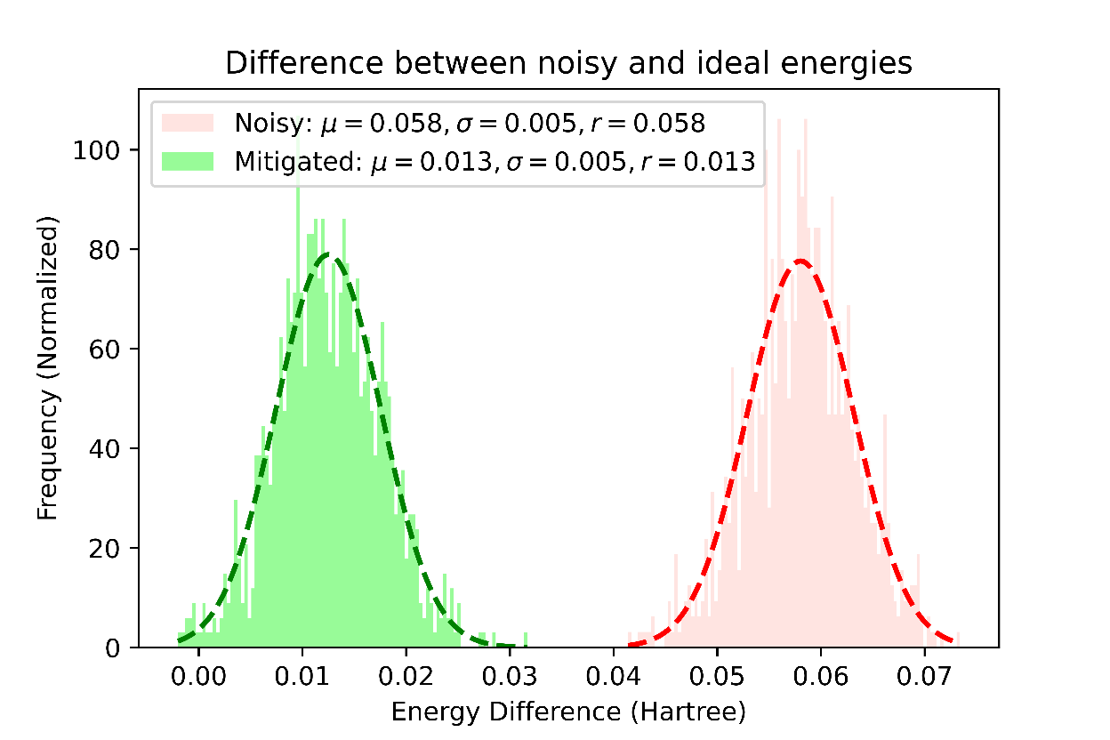
Restricted Range [(0.001, 0.002),(-0.002, -0.001), (-0.2, -0.1)] Only Readout Errors
Two Fold Majority Logic
Three Fold Majority Logic

Slide 7
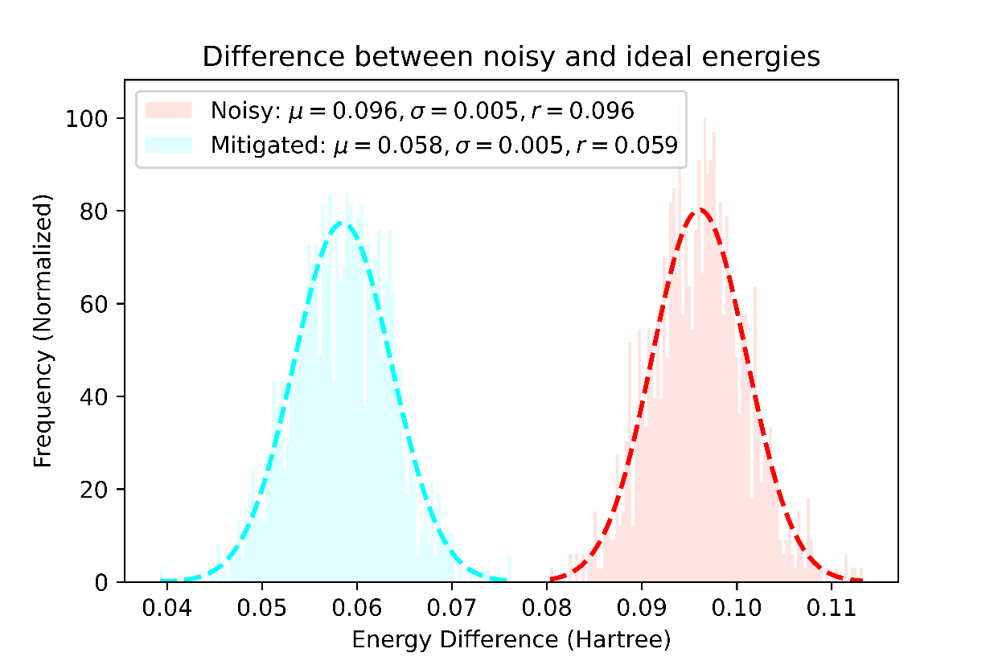
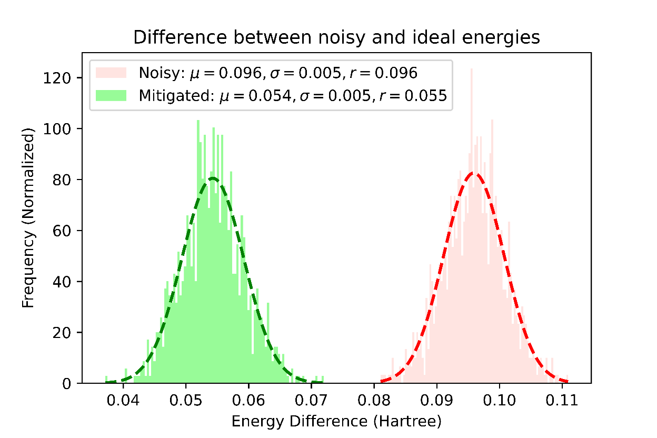
Optimized Parameters [ 0.00172129,-0.00182397, -0.11217598] Full Noise Model
Two Fold Majority Logic
Three Fold Majority Logic

